Slide 1
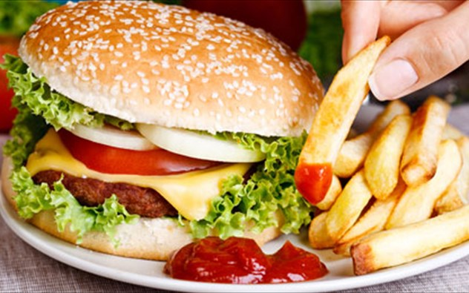
Where does our body get its energy from?

Slide 2
Where does our body get its energy from?
Carbohydrates
Fats
Proteins
Vitamins
Metals
are the basic nutritional components used by our organism for its growth and development

Slide 3
Where does our body get its energy from?
By consuming the appropriate quantities from each nutritional component, we help our organism to perform better and to develop more correctly

Slide 4
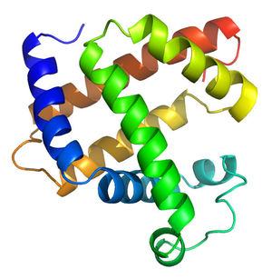
Proteins
They are complex macromolecules which form the basic structural cell elements, while at the same time playing a functional part in their structure and function.
They actively contribute to the composition of enzymes, hormones, haemoglobin and of antibodies.

Slide 5
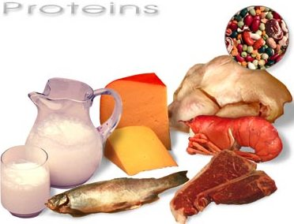
Proteins
Proteins are mainly found in foods derived from animals, such as meat, milk, fish and eggs, but also in many other plant-derived foods such as nuts, lentils and beans.

Slide 6
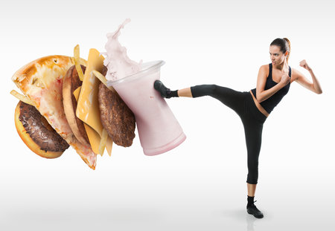
Where does our body get its energy from? Fats
Something that we must not eat?

Slide 7
Where does our body get its energy from? Fats
They act as a source and storage of energy
They are the structural elements of cell membranes
They act as message carriers (hormones), vitamins (liposoluble vitamins Α, D, E and Κ)
They offer protection and insulation

Slide 8
Where does our body get its energy from? Carbohydrates
Our organism uses these substances in order to acquire energy quickly and easily, so that it can fulfill our daily functions.

Slide 9
Carbohydrates
So, when we run to catch up with a friend, when we study to do well in an exam, when we play with a ball, we need a lot of energy.
We get this energy from carbohydrates.
The foods that are rich in carbohydrates are all fruits, vegetables, pastas, potatoes and all sweet foods.

Slide 10
Carbohydrates
Carbohydrates break into sugars
Monosaccharides
Glucose, Fructose, Galactose
Disaccharides
Sucrose or common sugar, Maltose, Lactose
Polysaccharides
Starch, Glycogen, Cellulose

Slide 11
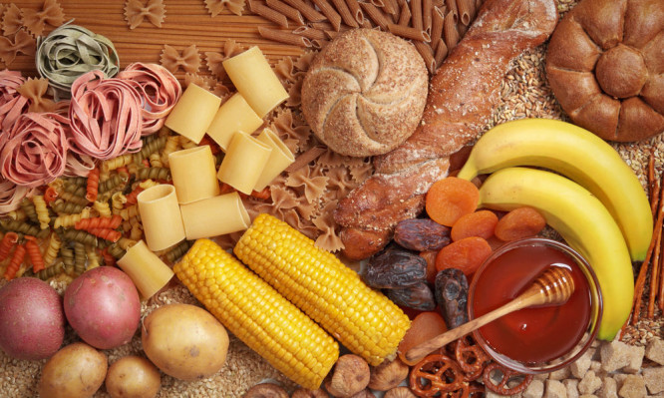

Slide 12
Where does our body get its energy from?
Inside a wide test tube we place a piece of caramel candy (bonbon) together with a small quantity of a white crystalline substance. As the tube gets heated over the burner, the bonbon burns inside a very bright white flame.

Slide 13
Where does our body get its energy from?
Instruments – Utensils – Materials
Wide Pyrex test tube
4ml spatula spoon
Metal stand with clamp
Laboratory burner
Caramel candies (bonbons)
Chemicals
Potassium chlorate (ΚClO₃), one level spoonful

Slide 14
Where does our body get its energy from?
Performing the experiment
We place first the bonbon and then the potassium chlorate inside the test tube, which is held in place on the metal stand with the clamp.
We move the lit burner close to the bottom of the test tube, at a distance of 8-10 cm. Very soon the tube contents will catch fire, producing an impressive white flame.

Slide 15
Where does our body get its energy from?
Interpretation
The bonbon is essentially sugar (C₁₂Η₂₂Ο₁₁)
When sugar is heated with ΚClO₃ (a good oxidizer), a violent exothermic reaction occurs, which can be formulated (in simplified terms) as follows (the Ο₂ comes from the ΚClO₃ breaking down):

Slide 16
C₁₂H₂₂O_{11(s)} + 12O_{2(g)} → 12CO_{2(g)} + 11H₂O_{(g)}

Slide 17
Where does our body get its energy from?
The amount of heat produced is approximately 6.5 kcal per gram (of sugar).
When a bonbon is eaten, this is metabolized inside our organism into CO₂ and H₂O, releasing the same amount of energy as the reaction above, but at a slower rate.

Slide 19
Welcome to Greece and have a nice holiday!

